Slide 1
Building demand for open data
Notes:
Today I will talk to you about:
Why the time is now
How the ODI is catalysing impact
Creating the right global conditions

Slide 2

Data is the raw material of the new industrial revolution
Notes:
People have long said that data is the raw material of the new industrial revolution
Without data you can’t have insight, and see what is really going on
Without data you can’t join things together and discover new ways of working
Without data you can’t have digital products and services
Open Data creates an environment where this data is freely avaialble

Slide 3
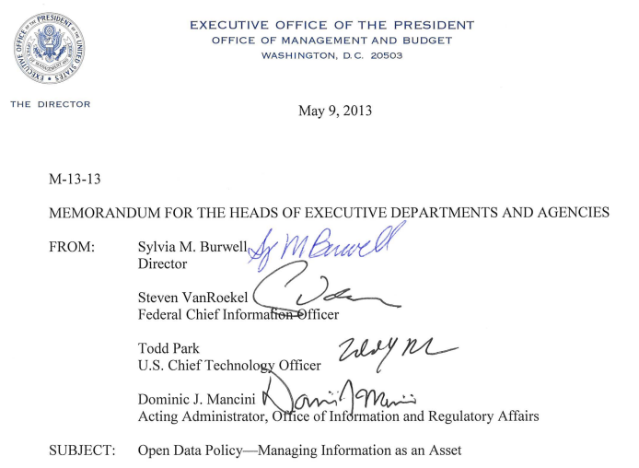
“Making Open and Machine Readable
the New Default for Government Information”
EXECUTIVE ORDER, BARACK OBAMA
http://www.whitehouse.gov/the-press-office/2013/05/09/obama-administration-releases-historic-open-data-rules-enhance-governmen
Notes:
Open is the the new default….
This is important because Government data is often central to a data ecosystem – it is the data that describes a country and a countries infrastructure.

Slide 4


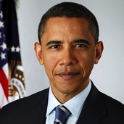
“Open Data is at the heart of
my agenda for Government”
Prime Minister Cameron, UK
“Open Data Strategy can enhance transparency and trust of government, and lead to economic revitalization”
(former) Prime Minister Noda, Japan
“Openness will strengthen our democracy
and promote efficiency and effectiveness in Government”
President Obama, USA
Notes:
There is now a global movement to open up Government data.
That is why it was a pivotal moment when the G8 signed up to the Open Data Charter

Slide 5
“a new era in which people can use open data to generate insights, ideas, and services
to create a better world for all”
G8 Open Data Charter 2013
Notes:
“a new era in which people can use open data to generate insights, ideas, and services
to create a better world for all”
G8 open data charter

Slide 6
Notes:
Last year the ODI was founded by Sir Tim Berners-Lee and Sir Nigel Shadbolt to create an environment that would unleash the impact of open data.
An environment that would bring together:
Entrepreneurs and industry;
Academia; and
The Public Sector

Slide 7


ODI has unlocked over £16m in its first year
“Creating an environment for others to be successful”
- £10^{m} public sector funding
- £3^{m} innovation funds & start-up contracts
- £3^{m} philanthropic and grant funding
- £800^{k} commercial bookings
Notes:
Been an amazing first year.
Been overwhelmed by the response we have had.
Over 7,000 people have visited our office
From over 20 countries; and
Importantly managed to find stories of impact [more on that later]

Slide 8

Credit: Press Association

Slide 9

Data as Culture
http://www.theodi.org/culture
The world’s first “Data as culture” art commission
+ 89 respondents from 20 countries in 2 weeks
+ Global coverage (WSJ, main TED conference in LA)
+ 3,000+ visitors to the ODI London space
+ Significant response from cultural leaders
“You’ve set the agenda for data as culture
-- so what’s next?”
Honor Harger, Creative Director, Lighthouse Arts
Stanza: Body 01000010011011110110010001111001
Notes:
The world’s first “Data as culture” art commission
+ 89 respondents from 20 countries in 2 weeks
+ Global coverage (WSJ, main TED conference in LA)
+ 3,000+ visitors to the ODI London space
+ Significant response from cultural leaders
“You’ve set the agenda for data as culture
-- so what’s next?”
Honor Harger, Creative Director, Lighthouse Arts

Slide 10
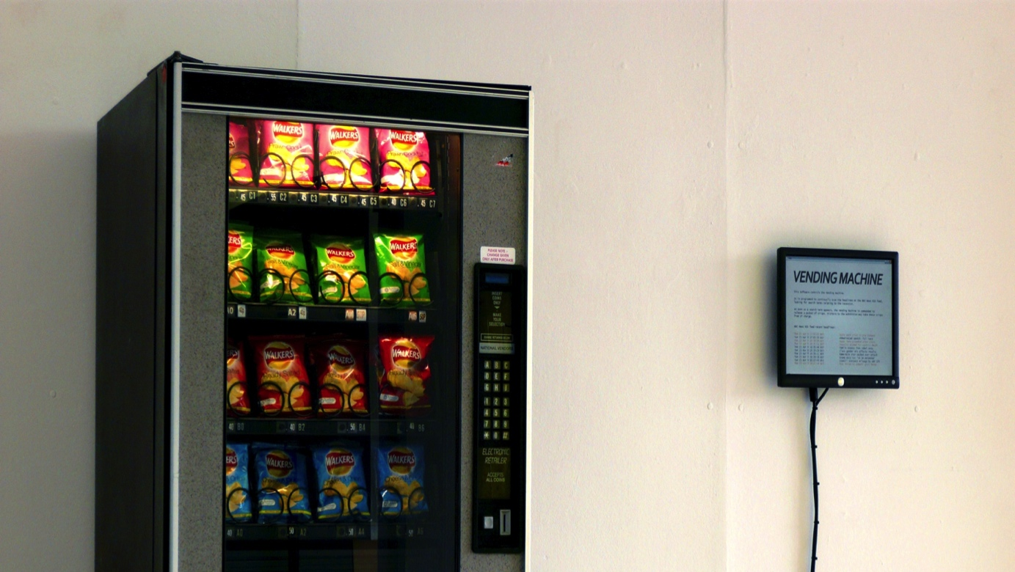
Ellie Harrison: Vending Machine
Notes:
This is my personal favourite – this vending machine doesn’t work on money or a swipe card – but on economic news.
Every time there is bad news in the UK economy it vends a packet of crisps – some junk food to cheer yourself up!

Slide 11
Public Services – innovation and savings
Civil Society – enables greater scrutiny
Private Sector – enhances services
Enables benefits across the economy
Notes:
I want to talk to you about some of the examples we have seen over the last year

Slide 12
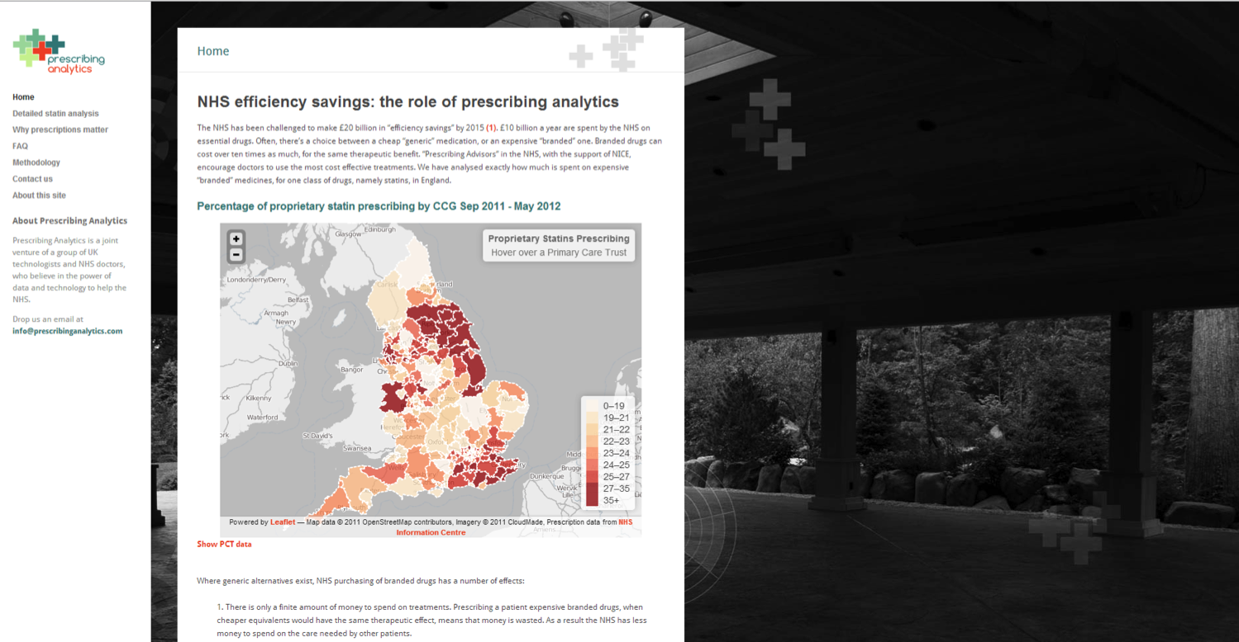
Notes:
£200m saving identified in the NHS drug budget

Slide 13
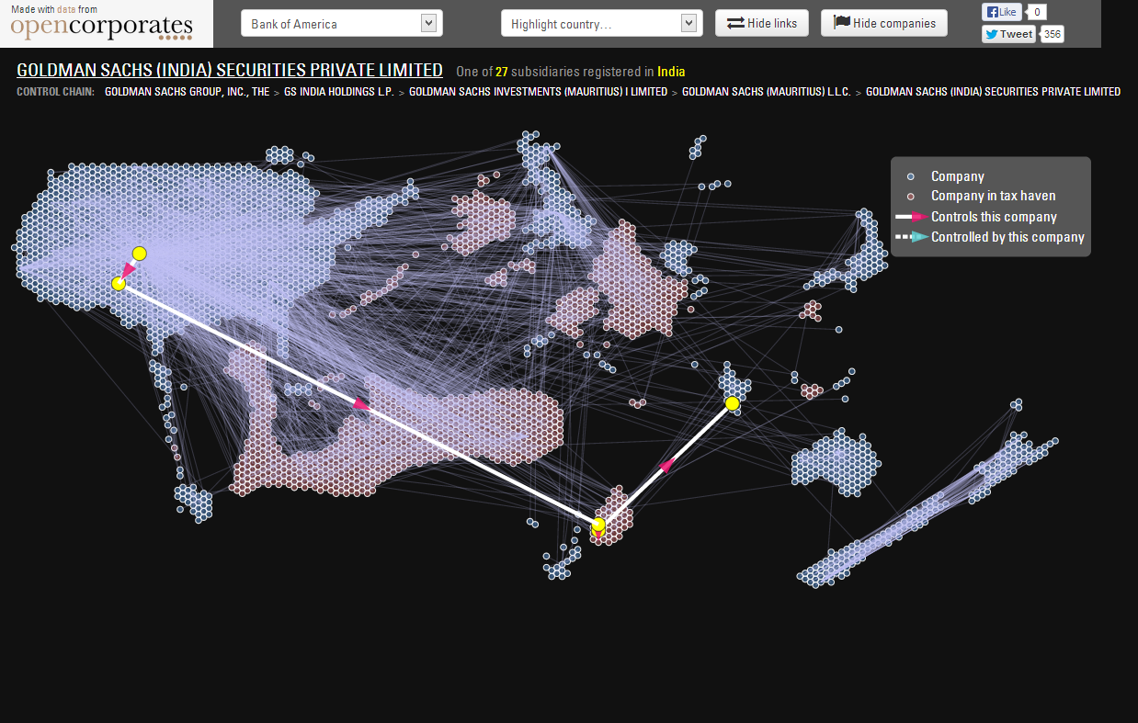
Notes:
Corporate structures revealed in from regulatory filings in the USA
Country is sized by the number of companies with >50% holding from Goldman Sachs.
You can see USA over here
UK here
The funny arm shaped country here is the cayman islands
I’ll let you draw your own conclusions on that.
This is insight that is very valuable to regulators, but needed data from 3 different regulatrs to be combined. Having worked inside Government I can tell you that data sharing agreement would have taken me a months/years to negotiate – with an open approach a 3rd party could come in, combine the data and resell the insight.

Slide 14
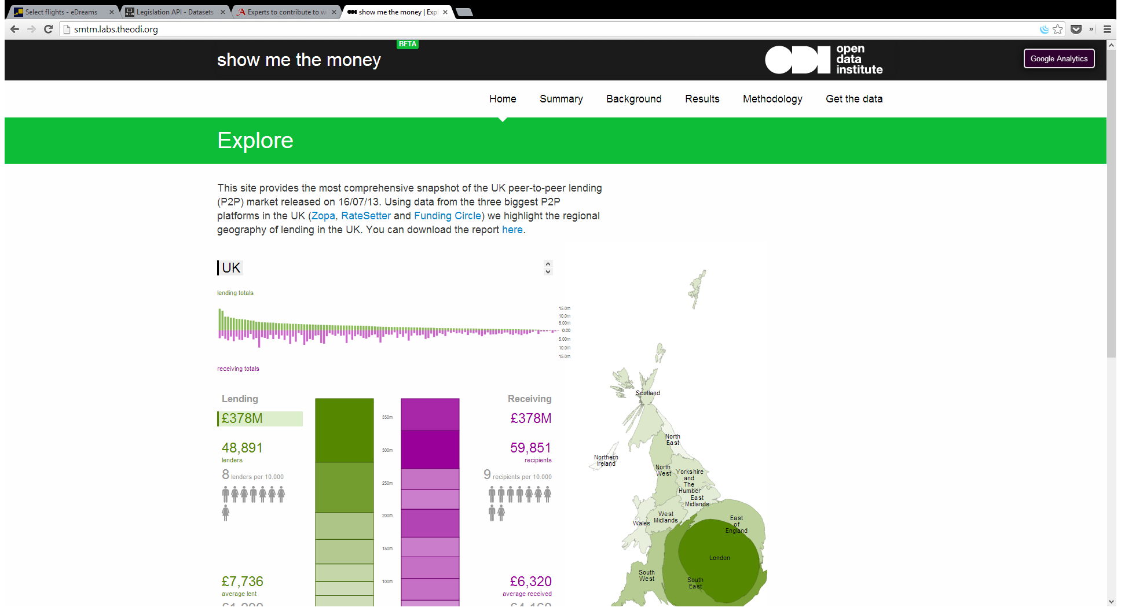

Notes:
Peer to peer lending – people lending direct to other people online – has grown in the UK from humble beginnings 10 years ago
After 10 years of double digit growth they are now not so humble. They have ~1% of the retail loan market.
We worked with industry to open up their data – suitably anonymised – and worked with the regulator to test hypotheses.
We proved from near-real time, point level data, that the market was well formed.
In the words of the Bank of England “Data Rich and regulation light”

Slide 15
ODI acts as a convening point around impact
Notes:
Convening a community round impact.
One of the first steps we took was to bring in startups…

Slide 16
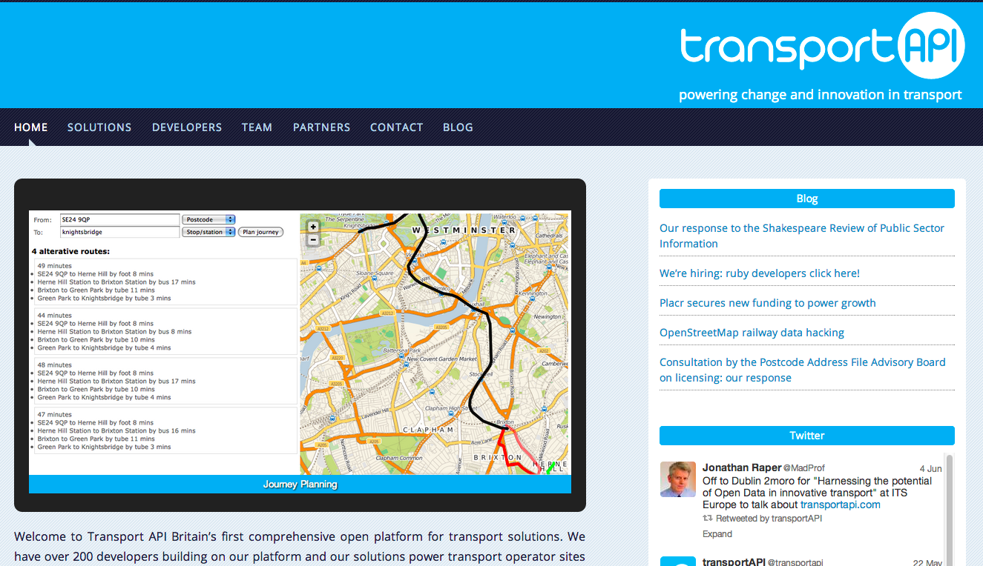
http://transportapi.com/
Notes:
Act a a microcosm of the membership programme
Helped Transport API close major funding round

Slide 17
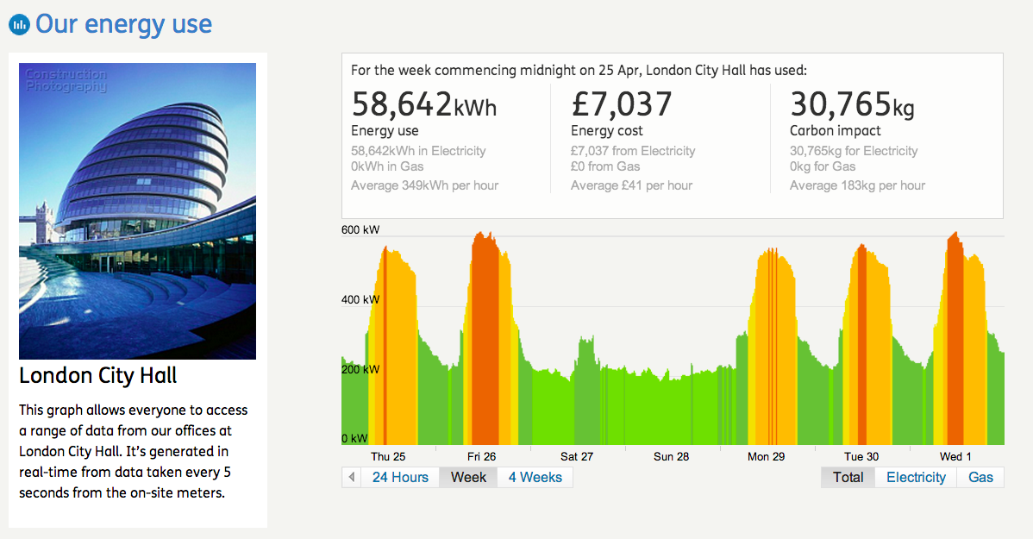
http://www.carbonculture.net/
Notes:
Real time energy use to feed in to behaviour change.

Slide 18
Global demand
Global challenges
Government leadership
Open Data Charter
Commercial value
A unique moment
Emerging Standards
Third sector engagement
Investment in Open
Growing capabilities
Global community

Slide 19

http://certificates.theODI.org
The first robust quality badge for open data
            Helps publishers certify their data
            Helps users find and use it
            Helps policy makers control & benchmark
Notes:
The first robust quality badge for open data
Helps publishers certify their data
Helps users find and use it
Helps policy makers control & benchmark
Moves from the technical standards into the Service Level Agreement for data – the social side of supply.
If the believe data is the raw material then these certificates give you certainty of supply.

Slide 20


An exceptional example of information infrastructure.
Regularly published open data with robust support
that people can rely on.
Data users receive extra support from, and can provide
feedback to a publisher.
A great start at the basics of publishing open data.
http://certificates.theODI.org
Notes:
Looking for a genuinely mixed economy.
Expert is not appropriate for everything – it is a very high bar! It might be appropriate for publishing a core reference data set like e.g. company numbers.
Raw is a great start for getting started in publishing data sets for general reuse.

Slide 21

Notes:
Now building up a network of organisations worldwide who can help convene that community around impact

Slide 22




ODI Nodes
=
Businesses + Universities + NGOs
ODI Nodes connect the organisations that
support open data projects and people

Slide 23



Supporting local, national and international impact
Country Node
Country-lead, close to government, independent
City or Region Node
Deliver projects, training,
research, and development
Communications Node
Amplify use-cases to,
and from, around the world

Slide 24

Many parts, loosely joined. Amplify what's there.
A. Adopt the ODI charter
B. License ODI Node brand
C. Listing in ODI Node registry
ODI Charter
+ vision, mission, values
+ brand
+ communications
+ standards
+ governance
+ services

Slide 25
Notes:
End here!

Slide 26
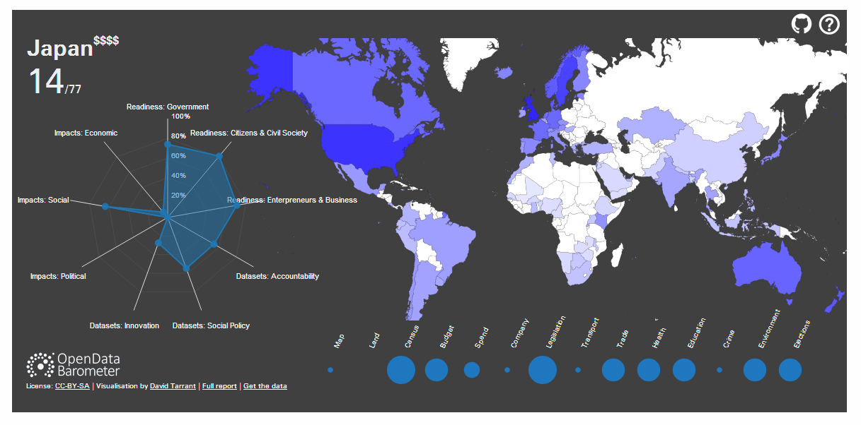
Open Data Barometer: Japan
Notes:
Open Data Barometer: Japan

Slide 27
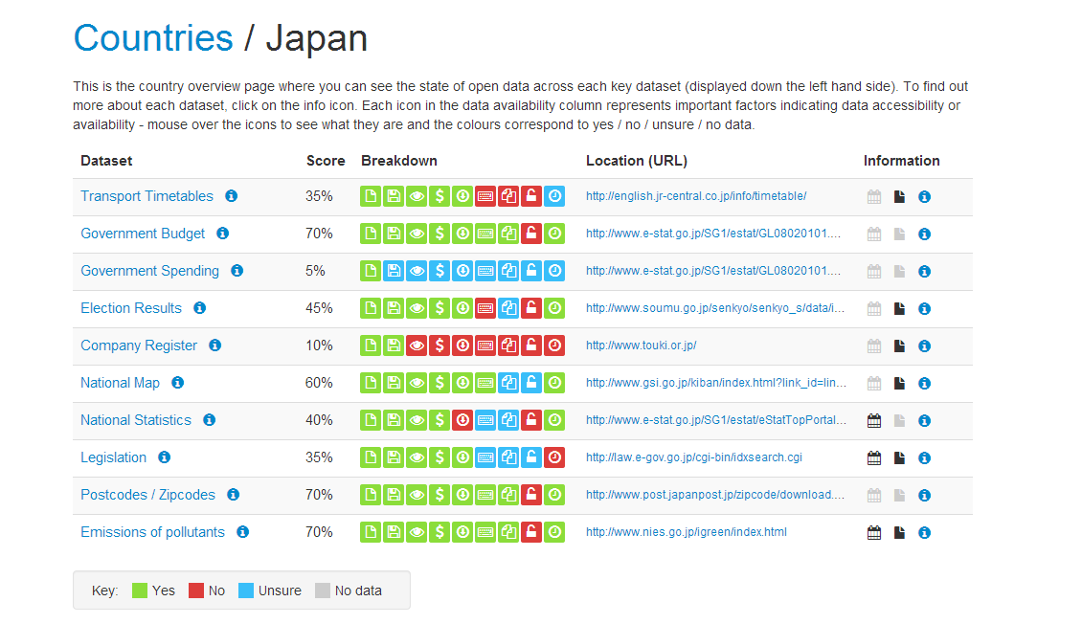
Open Data Census: Japan
Notes:
Open Data Index: Japan

Slide 28
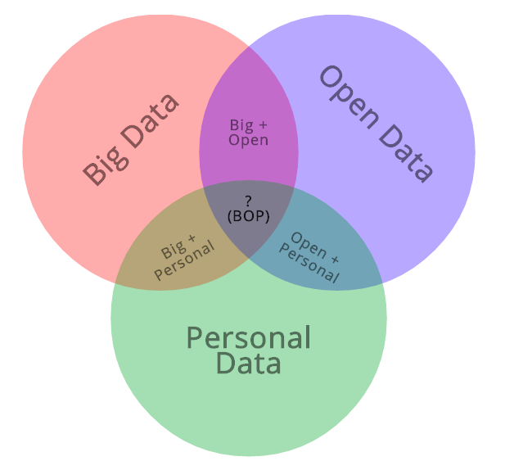
Big. Open. Personal.
Notes:
Venn diagram: big, open and personal data

