Slide 1
Ref. 3-3
Utilization and Promotion Committee
Report of Activities of 2012 and Proposed Activities (Draft) of 2013
2013.6.13
Open Data Promotion Consortium
Ichiya Nakamura
Chief Researcher,
Utilization and Promotion Committee
This document is a provisional translation by Open Data Promotion Consortium

Slide 2
1. Utilization and Promotion Committee’s Report of Activities of 2012
Date | Title | Overview
2012.07.27 | Consortium Foundation Presentation | Held at Yamagami Hall, Tokyo University with some 80 participants.
2012.09.28 | 1st UD Committee Meeting | Discussed planned study items and way of proceeding.
2012.11.05 -12.01 | Meteorological Data & Ideathon | Organized on Facebook in collaboration with the Meteorological Agency. More than 100 participants.
2012.11.07 | 2nd UD Committee Meeting | Studied the US case of open data, and others.
2012.11.22 | Decision of Consortium Logo | Selected through candidate invitation on Crowd-Sourcing service.
2012.12.01 | Meteorological Data & Hackathon | Held at the Mitsubishi Research Institute following the results of Ideathon with some 50 participants.
2012.12.10 | Symposium on Open Data | Jointly organized with the Ministry of Communications, held at Ito Hall of Tokyo Univ. with some 260 participants.
2012.12.28 | Renewal of the Consortium Website | Renewed to the present Website.
2013.01.22 | 3rd UD Committee Meeting | Studied the cases of open data in Japan.
2013.01.22 -03.06 | Review of Candidates & Selection of Prize Winners | Out of 76 open data cases collected by the Secretariat, the review and selection was made.
2013.3.13 | 4th UD Committee Meeting, Commendation Ceremony | Reported the activities of 2012, and discussed the plan of activities of 2013. Awarded prizes to 13 organizations.

Slide 3
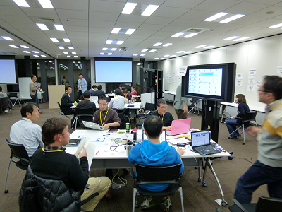

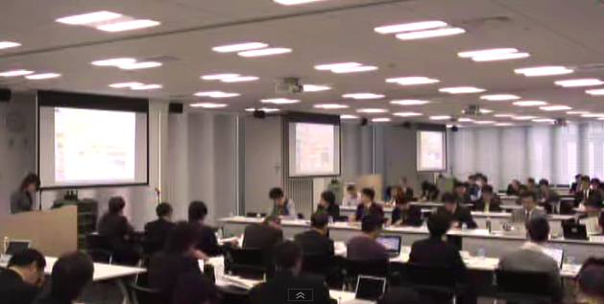
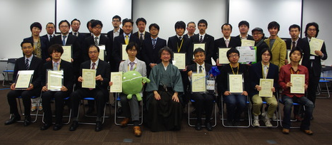
1. Utilization and Promotion Committee’s Report of Activities of 2012
Meteorological Data & Hackathon （2012.12.01）
Symposium on Open Data（2012.12.10）
Utilization and Promotion Committee (4 meetings)
Commendation at the Committee’s Discretion（2013.03.13）

Slide 4
2. Trends of Open Data in Japan
■ Summing Up 2012：Japan’s 1st year of Open Data
・Open-Data-related enthusiastic organizations including Open Knowledge Foundation Japan, Yokohama Open Data, Linked Open Data Initiative, etc. were established and started their activities.
・The government organized the E-Government Open Data Working Level Meeting and is considering launching the road map, guidelines and data catalogue website etc. It also gives the high priority to open data in their new Information Technology Strategy.
・Local authorities including Cities of Sabae, Yokohama, Chiba, Nagareyama, Aizuwakamatsu and Aomori Prefecture have also started open data efforts.
・The International Open Data Day held on Feb. 23, 2013 attracted more than 100 participating cities in the world including 8 Japanese municipalities.
■ Prospects of 2013：Initiation of Full-Blown Activities
・The general recognition of open data is not necessarily high yet. The collaboration of businesses, government and academics is essential for further enhancement of the recognition of the general public.
・The emergence of open-data-based issue-solution cases or businesses, irrespective of their size, is important. The collaboration of businesses, government and academics is indispensable in this case as well.

Slide 5
3. Requests from Members regarding the Committee’s
Activities of 2013 (1)
Results of the Questionnaire Survey to Committee Members on Activities of 2013
■ Outline of Survey
■ Respondents’ Attribute (Plural Answers Allowed)
Period | Jun. 4, 2013 (Tue)～Jun. 7, 2013 (Fri.)
Survey Method | Web Questionnaire
Survey Target | Members as of June 3, 2013 ・Corporate Members ：96 ・Municipality Members：10 ・Learned Members ： 5
Respondents | 67
Survey Items | How are you concerned with open data ? Your data put open to the public Data scheduled to be put open to the public Open data you are utilizing Data you expect to be open New services you intend to start when you get open data Your request for activities of each Committee of the Consortium Your request for activities of the Consortium Activities you want to introduce in the Consortium
Many of the respondents were users and mediators of data.
【Other Respondents】
Those who assist businesses’ data utilization.
Those who assist data owners’ data
disclosure.

Slide 6
3. Requests from Members regarding the Committee’s
Activities of 2013 (2)
Situations, Utilization and Needs of Open Data
■ Data Put Open to the Public by Data Owners
■ Data You Expect to be Put Open to the Public
Statistical Data Owned by Municipalities
Water Quality / Waterfront Environment Improvement Cycle Portal Site
General Scientific & Technological Information
Library Information
Business Statistics, etc.
Statistical Information linked with Geographical Info.
More Detailed Government Data
Geospatial Data Owned by the Private Sector
Disaster Prevention Information
Traffic Accidents Data, etc
■ Open Data being Utilized
■ New Services You Intend to Start when You
Get Open Data
Database of Car Navigation Systems with Accident Prevention Function and Their Logic Development
Information Provision Services for the General Public regarding Disaster, Ground (Geology) Risk etc.
Information Services on Air Contamination and Related Resident Support
Marketing Designing Services to Support Community Revitalization
Cross Search Services of Record of Proceedings of Local Assemblies, etc.
The mainstay is the usage of the government statistical data and meteorological data.
Whereas some members have highly specific service images, there exist many members who replied they were still in consideration. Cross-cutting considerations among data owners, mediators and users are essential.

Slide 7
3. Requests from Members regarding the Committee’s
Activities of 2013 (3)
Sophistication of Open Data Utilization Promotion System
Provision of the Venue for Members for Active Discussion
Closer Collaboration with the Government’s Open Data Strategy
Development of Open Data Utilization Environment
Development of the Platform for Easier Data Utilization with Wider Range of Information (together with Consolidation of Data Catalogues)
Establishment of Business Models
Introduction of Examples of Open Data Utilization of Member Corporations as well as Advanced Examples of Foreign Countries
Consideration of Starting Businesses utilizing Sample Data
Establishment of Business Models for Local Enterprises utilizing Open Data

Slide 8
4. Utilization and Promotion Committee’s Proposed
Activities (Draft) in 2013
(1) Proposed Activities (Draft)
① Dissemination of needs of open data users. For example, dissemination of local data needs to community-based businesses.
② Closer collaboration with the Technology and Data Governance Committees. Conveyance of users’ needs, views and requests in terms of technology and rules of usage, etc. to these Committees.
③ Closer collaboration and synergy with other stakeholders. Promotion of nationwide open data movement including joint organization or support of events, joint research etc.
(2) Major Activities (Draft)
Title | Outline
Symposium | Information Dissemination of Open Data (Time & Contents : TBD)
Utilization and Promotion Committee | 4 times during July 2013 to Mar. 2014 / Closer collaboration with other Committees
Ideathon / Hackathon | Organization of Theme-Specific Ideathon / Hackathon
Commendation at the Committee’s Discretion | Commendation of Excellent Examples of Open Data
Apprehension of Needs | Apprehension of Businesses’ Needs of Open Data (incl. Member Corporations & Organizations)
Support to Members’ Activities | Support to Open Data Activities
Information Dissemination | Strengthening of Website Information Dissemination
Others | Support or joint organization of events, joint research etc.

